Slide 1
Thread, Async Task, Broadcast Receiver and Service

Slide 2
Agenda
Thread
  Callbacks, Lifecycle
  Creating a Thread
Async Task - Deprecated Now
Broadcast Receiver
  Creating, Registering and Lifecycle
Service

Slide 3
Thread
A thread is a single sequential flow of control within a program. When a program(sequence of steps) execute in Java, that’s called Thread.
Main Thread in Java
When a Java program starts up, one thread begins running immediately. This is usually called the main thread of our program, because it is the one that is executed when our program begins.

Slide 4
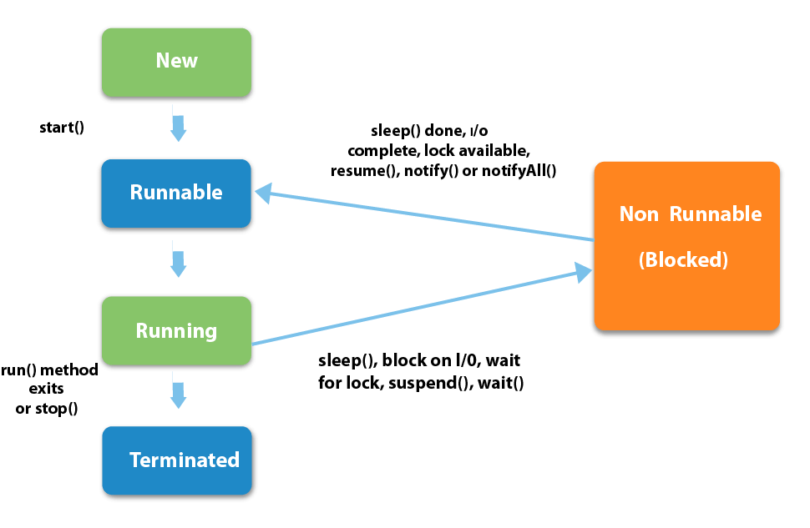
Thread Callbacks

Slide 5
Thread Lifecycle
The life cycle of the thread in java is controlled by JVM. The java thread states are as follows:
New - The thread is in new state if you create an instance of Thread class but before the invocation of start() method.
Runnable - The thread is in runnable state after invocation of start() method, but the thread scheduler has not selected it to be the running thread.
Running - The thread is in running state if the thread scheduler has selected it.
Non-Runnable (Blocked) - This is the state when the thread is still alive, but is currently not eligible to run.
Terminated - A thread is in terminated or dead state when its run() method exits.

Slide 6
Creating a Thread
Extending a Thread Class
class MyThread extends Thread{
@Override
public void run(){
super.run();
System.out.println(“My Thread is running”)
}
}
execution - new MyThread().start()

Slide 7
Creating a Thread
implementing a running interface
class MyThread implements Runnable{
@Override
public void run(){
super.run();
System.out.println(“My Thread is running”)
}
}
execution - new MyThread(new MyThread()).start()

Slide 8
Advantages and Disadvantages
Advantages -
easier to program
  1 Thread per task
can provide better performance
  thread only runs when needed
  no polling to decide what to do
multiple threads can share resources
utilize multiple processors if available
Disadvantages
multiple threads can lead to deadlock.
overhead of switch a Threads.

Slide 9
AsyncTask
AsyncTask is an abstract Android class which helps the Android applications to handle the Main UI thread in efficient way. AsyncTask class allows us to perform long lasting tasks/background operations and show the result on the UI thread without affecting the main thread.

Slide 10
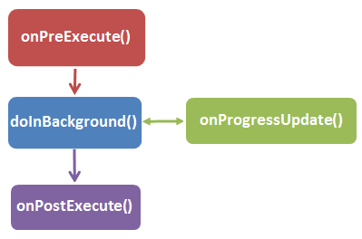
AsyncTask LifeCycle

Slide 11
Advantages
Provides generic solution for all network calls
Publish progress to UI while executing.
Run Asynchronously
Easy to maintain and read.

Slide 12
Disadvantages
When you rotate your screen, Activity gets destroyed, so AsyncTask will not have a valid reference to publish data from onPostExecute(). In order to retain it, you need to usesetRetainState(true) if calling from fragment or onConfigChanges() if calling from activity method of an activity.
If activity gets finished, AsyncTask execution will not cancelled automatically, you need to cancel them else they will keep on running in the background.
If any exception occurs while performing network task, you need to handle them manually.

Slide 13
Intent
An Intent is a messaging object you can use to request an action from another app component.
Although intents facilitate communication between components in several ways, there are three fundamental use cases:
Starting an Activity
Starting a Service
Delivering a broadcast

Slide 14
Broadcast Receiver
A broadcast receiver is an Android component which allows you to register for system or application events. All registered receivers for an event are notified by the Android runtime once this event happens.
For example, applications can register for the ACTION_BOOT_COMPLETED system event which is fired once the Android system has completed the boot process.

Slide 15
Lifecycle of BroadcastReceiver
A BroadcastReceiver object is only valid for the duration of the call to onReceive(Context, Intent). Once your code returns from this function, the system considers the object to be finished and no longer active.

Slide 16
Registering the BroadcastReceiver
Statically Via AndroidMenifest.xml
Dynamically via Context.registerReceiver()

Slide 17
Static Registration
Step-1
in androidmanifest.xml in application tag
<receiver android:name=".PhoneStateReceiver">
<intent-­‐filter android:priority=”5">
<action android:name= "android.intent.action.PHONE_STATE/>
</intent-­‐filter>
</receiver>

Slide 18
Static Registration
Step-2
Create a BroadcastReceiver class
public class PhoneStateReceiver extends BroadcastReceiver{
@Override
public void onReceive(Context context, Intent intent) {
}
}

Slide 19
Dynamic Registration
Step-1
Create a BroadcastReceiver class
public class UpdateUiReceiver extends BroadcastReceiver{
@Override
public void onReceive(Context context, Intent intent) {
}
}

Slide 20
Dynamic Registration
Step-2
Register Broadcast Receiver
UpdateUiReceiver receiver = new UpdateUiReceiver();
context.registerReceiver(receiver, new IntentFilter(CUSTOM_INTENT));

Slide 21
Dynamic Registration
Step-3
Un Register Broadcast Receiver
context.unRegisterReceiver(receiver);

Slide 22
Some Security point needed to be considered
The Intent namespace is global. Make sure that Intent action names and other strings are written in a namespace you own, or else you may inadvertently conflict with other applications.
When you use registerReceiver(BroadcastReceiver, IntentFilter), any application may send broadcasts to that registered receiver. You can control who can send broadcasts to it through permissions described in next point.
When you publish a receiver in your application's manifest and
specify intent-filters for it, any other application can send broadcasts to it regardless of the filters you specify. To prevent others from sending
to it, make it unavailable to them with android:exported="false"
When you use sendBroadcast(Intent) or related methods, normally any other application can receive these broadcasts. You can avoid it by using LocalBroadcastManager.

Slide 23
Service
A Service is an application component representing either an application’s desire to perform a longer-running operation while not interacting with the user or to supply functionality for other applications to use.

Slide 24
Characteristics of Service
A service is a application component used to perform long running tasks in background.
A service doesn’t have any user interface and neither can directly communicate to an activity.
A service can run in the background indefinitely, even if component that started the service is destroyed.
Usually a service always performs a single operation and stops itself once intended task is complete.
A service runs in the main thread of the application instance. It doesn’t create its own thread. If your service is going to do any long running blocking operation, it might cause Application Not Responding (ANR). And hence, you should create a new thread within the service.

Slide 25
Start a service
There are two way start a service -
startService();
boundService();

Slide 26
Start a service
A service is started when an application component, such as an activity, starts it by calling startService(). Once started, a service can run in the background indefinitely, even if the component that started it is destroyed.

Slide 27
How to start a Service
Declare in Menifiest -
<service
android:name="MyService"
android:icon="@drawable/icon"
android:label="@string/service_name" />
Run a Service -
Intent i= new Intent(context,MyService.class);
// potentially add data to the intent
i.putExtra("KEY1", "Value1");
context.startService(i);

Slide 28
How to stop a Service
Intent i= new Intent(context,MyService.class);
context.stopService(i);
Notes:
The Intent class specifies many EXTRA_* constants for standardized data types. If you need to declare your own extra keys (for intents that your app receives), be sure to include your app's package name as a prefix, as shown in the following example:
static final String EXTRA_GIGAWATTS = "com.example.EXTRA_GIGAWATTS"

Slide 29
Bound a Service
A service is bound when an application component binds to it by calling bindService(). A bound service offers a client-server interface that allows components to interact with the service, send requests, get results, and even do so across processes with interprocess communication (IPC).

Slide 30
Bound a Service
private MyService myServiceBinder;
public ServiceConnection myConnection = new ServiceConnection() {
public void onServiceConnected(ComponentName className, IBinder binder) {
myServiceBinder = ((MyService.MyBinder) binder).getService();
showServiceData();
}
public void onServiceDisconnected (ComponentName className){
myService = null;
}};

Slide 31
Bound a Service
public void doBindService() {
Intent intent = null;
intent = new Intent(this, BTService.class);
// Create a new Messenger for the communication back
// From the Service to the Activity
Messenger messenger = new Messenger(myHandler);
intent.putExtra("MESSENGER", messenger);
bindService(intent, myConnection, Context.BIND_AUTO_CREATE);
}

Slide 32
Bound a Service
/*
Return our Messenger interface for sending messages to
the service by the clients.
*/
@Override
public IBinder onBind(Intent intent) {
Log.d(TAG, "onBind done");
return mMessenger.getBinder();
}
example - https://www.techotopia.com/index.php/Android_Local_Bound_Services_%E2%80%93_A_Worked_Example

Slide 33
Intent Service
Creates a default worker thread that executes all intents delivered to onStartCommand() separate from your application's main thread.
Creates a work queue that passes one intent at a time to your onHandleIntent() implementation, so you never have to worry about multi-threading.
Stops the service after all start requests have been handled, so you never have to call stopSelf().
Provides default implementation of onBind() that returns null.
Provides a default implementation of onStartCommand() that sends the intent to the work queue and then to your onHandleIntent() implementation.

Slide 34
Difference between Intent Service and Service
Service class uses the application's main thread, while IntentService creates a worker thread and uses that thread to run the service.
IntentService creates a queue that passes one intent at a time to onHandleIntent(). Thus, implementing a multi-thread should be made by extending Service class directly.
Service class needs a manual stop using stopSelf(). Meanwhile, IntentService automatically stops itself when there is no intent in queue.
IntentService implements onBind() that returns null. This means that the IntentService can not be bound by default.
IntentService implements onStartCommand() that sends Intent to queue and to onHandleIntent().

Slide 35
Exercise
Create an application which is having button start on click it will start Asynctask and will download an image from internet and will show image on imageview. If user goes back from page it should cancel the download (If download is in the middle). During an application running, If internet connect or disconnect, It should pause the download or resume the download and show toast message of connectivity status.
Create one more button on same page which will do same task (download image) but with help of Service not with Asynctask.
Show the download progress in a progress bar.

Slide 36
THANK YOU

